Slide 1
ML for Security and Security for ML

Slide 2
#> whoami
Nikhil Joshi
AI Security Engineer

Slide 3
DL ML AI

Slide 4
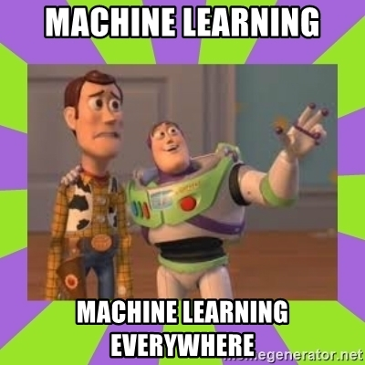
ML/DL Intro: What for?
Pattern matching
Pattern search
Classification
Regression
Clustering
Forecasting
etc.

Slide 5
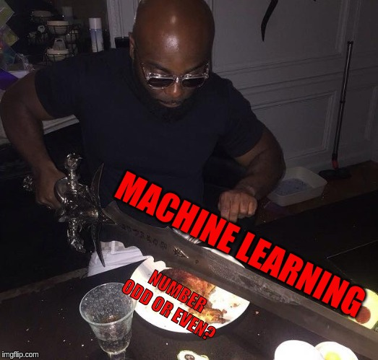
Where not to use ML?

Slide 6
Applications in security
WAF
IDS/IPS
Malware detection
Antiviruses
Spam filters
...

Slide 7






Libs

Slide 8




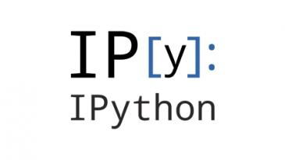
Execution Tools

Slide 9
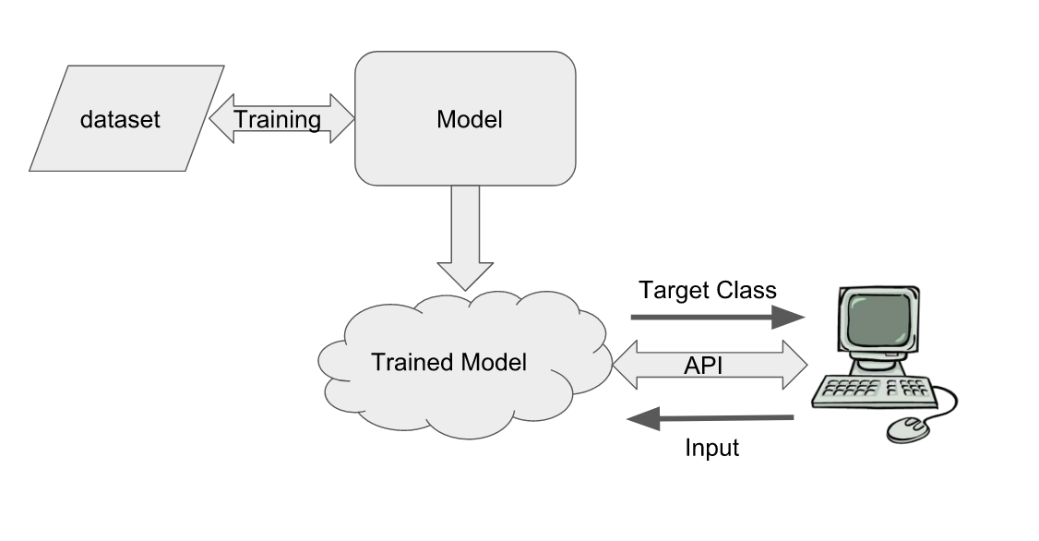
How it works in production

Slide 10
Basic Terminology
Dataset
Features and Labels
Training set and Testing set
Probability
Model
Loss function
Optimization
Overfitting
Underfitting

Slide 11
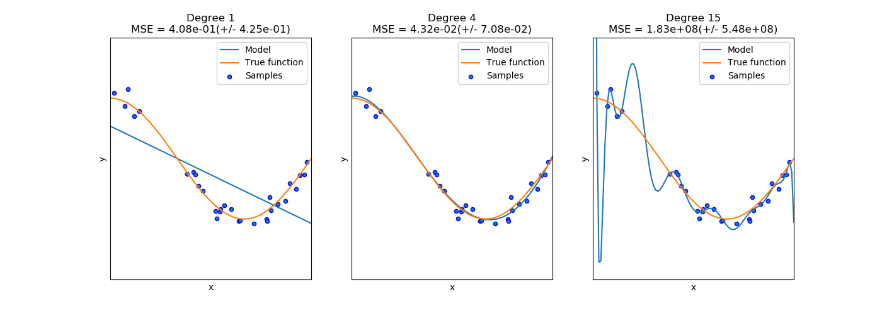
Underfitting vs Overfitting
Source: https://scikit-learn.org/

Slide 12
Basic Terminology
Supervised Learning
Unsupervised Learning
Semi-supervised Learning

Slide 13
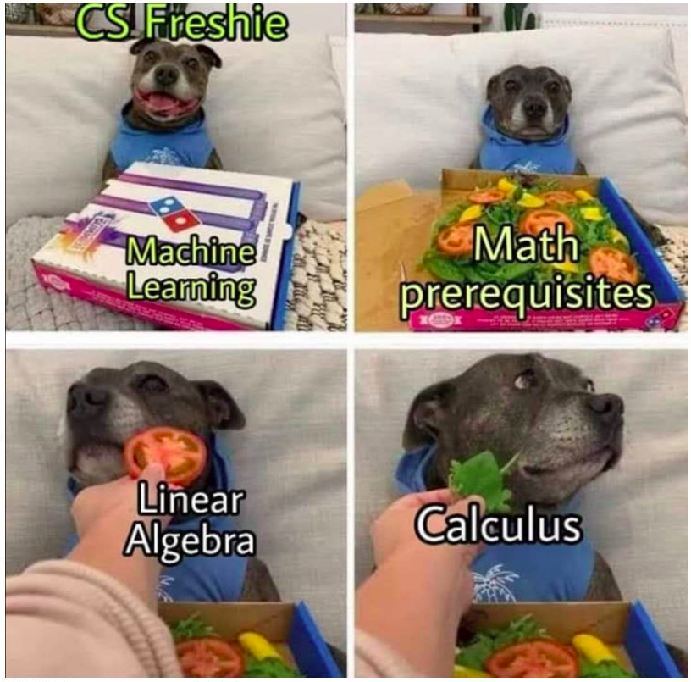
I know, right!

Slide 14
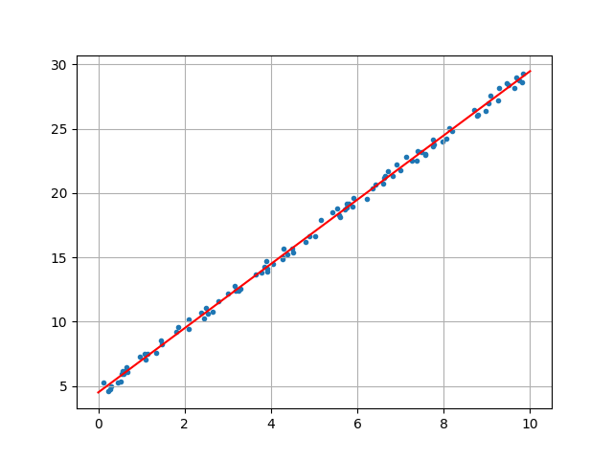
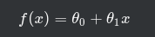
Linear Regression

Slide 15
Demo: Linear Regression

Slide 16
Classification

Slide 17
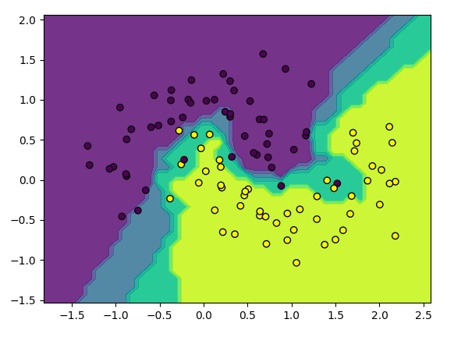
Classification

Slide 18
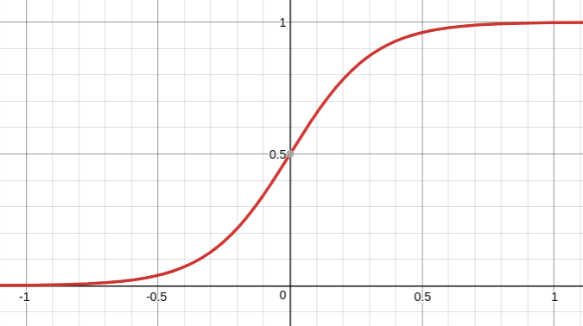
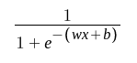
Logistic Regression

Slide 19
Logistic Regression

Slide 20
Logistic Regression
Desmos me

Slide 21
WAF using Logistic regression
Ref: https://github.com/faizann24/Fwaf-Machine-Learning-driven-Web-Application-Firewall

Slide 22
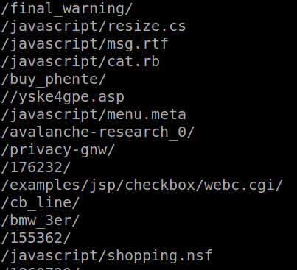
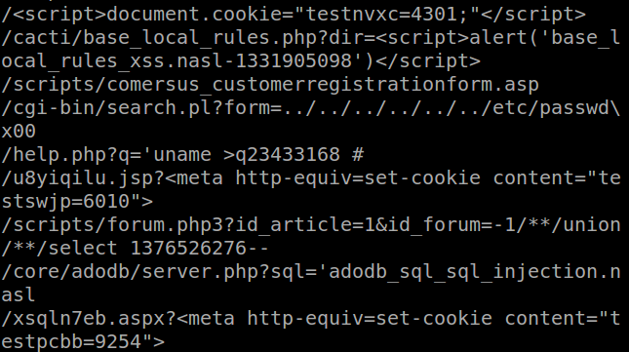
Dataset
Good queries
Bad queries

Slide 23
Preprocessing data

Slide 24
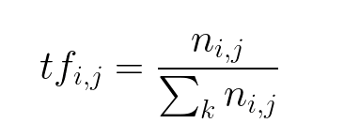
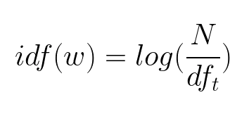
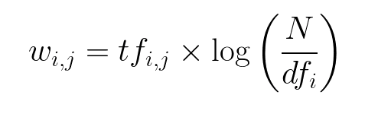
TF-IDF

Slide 25
TF-IDF
Term Frequency: This summarizes how often a given word appears within a document.
Inverse Document Frequency: This downscales words that appear a lot across documents.
https://medium.freecodecamp.org/how-to-process-textual-data-using-tf-idf-in-python-cd2bbc0a94a3

Slide 26
Demo: WAF using Logistic regression
Ref: https://github.com/faizann24/Fwaf-Machine-Learning-driven-Web-Application-Firewall

Slide 27
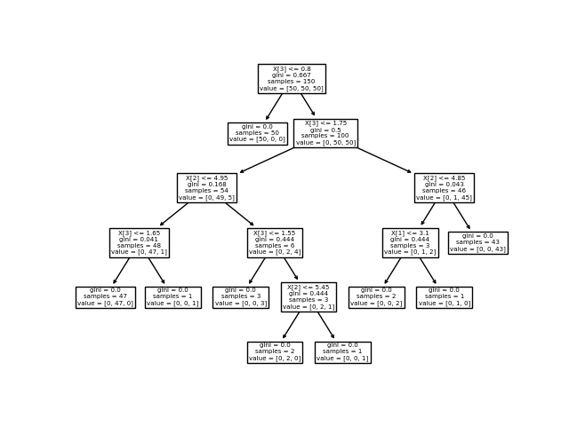
Decision Tree and Random Forest

Slide 28
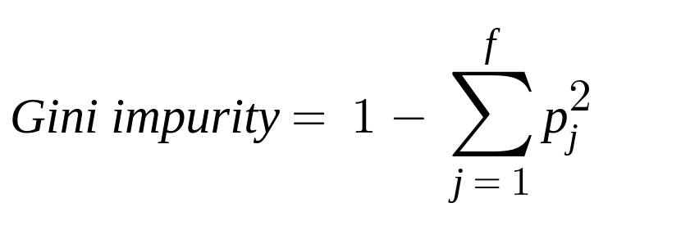
Decision Tree and Random Forest
Gini Impurity: Gives you a likelihood of incorrect classification
Calculate Gini impurity for all possible features
Add the node to tree if improved Gini impurity value is seen
Else do not fork the tree

Slide 29
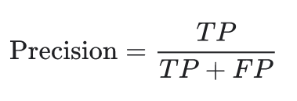
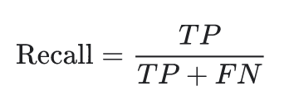
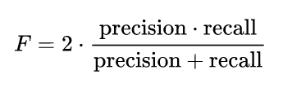
Evaluation: Precision, Recall and F1 score
Precision: What proportion of positive identifications was actually correct?
Recall: What proportion of actual positives was identified correctly?
F1 score:

Slide 30
Malware Classifier

Slide 31
Dataset: Malware Classifier
56 features extracted from PE files using pefile
2 classes
138047 samples
https://github.com/Te-k/malware-classification

Slide 32
Neural Net

Slide 33
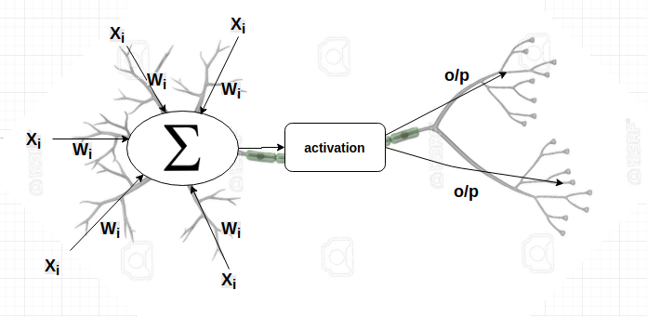
Building Block

Slide 34
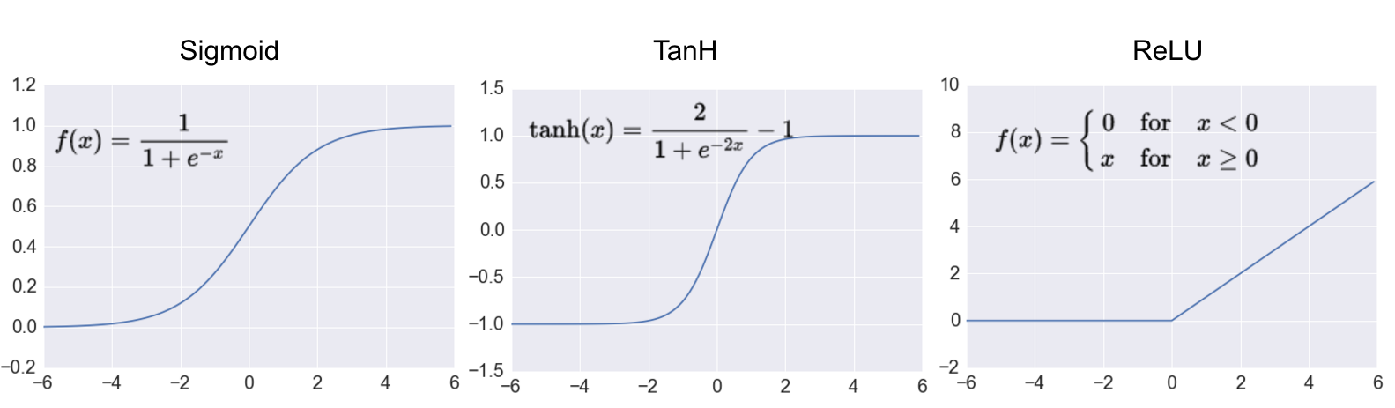
Activation functions

Slide 35
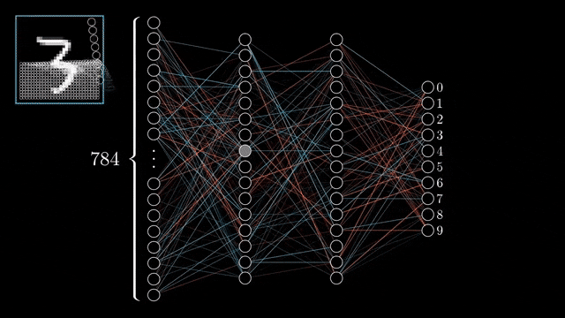
Initialization
Gif is taken from 3blue1brown’s video

Slide 36
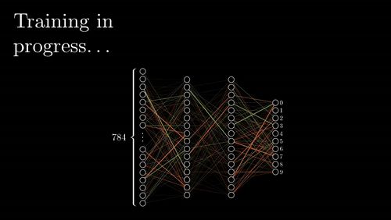
Training
Gif is taken from 3blue1brown’s video

Slide 37
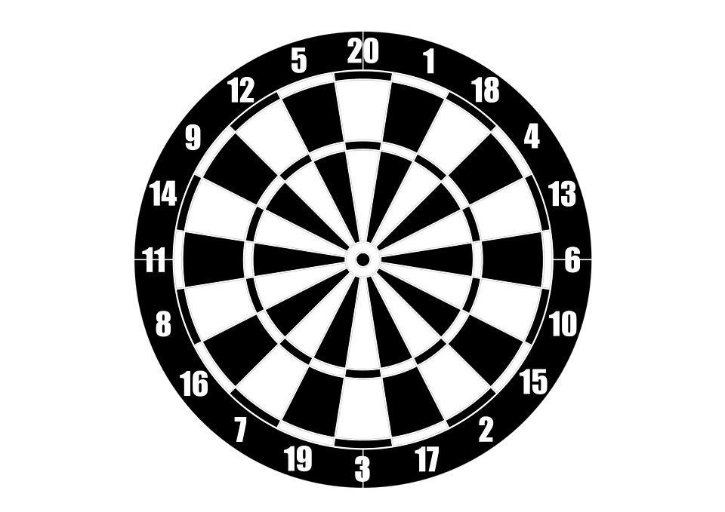
Learning
P1
P2

Slide 38
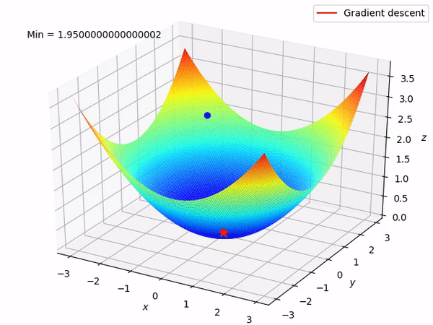
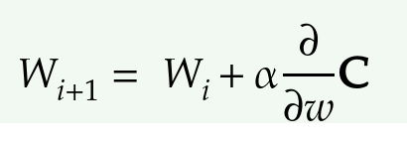
Maths behind Learning

Slide 39
Optimization Algorithms
Loss function
Input Parameters
Trained
Parameters
Optimizer
{W, b}
{W, b}

Slide 40
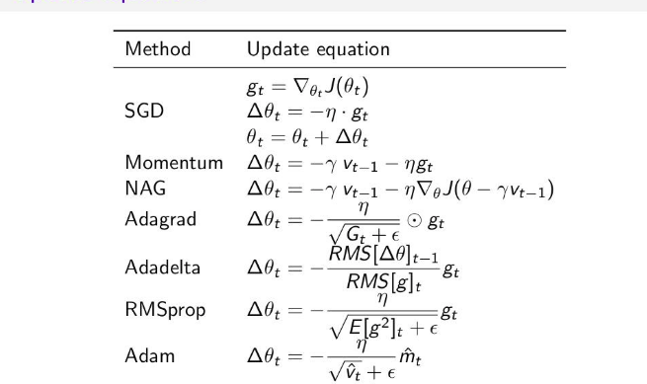

Slide 41
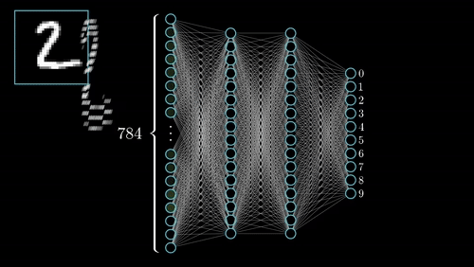
Prediction
Gif is taken from 3blue1brown’s video

Slide 42
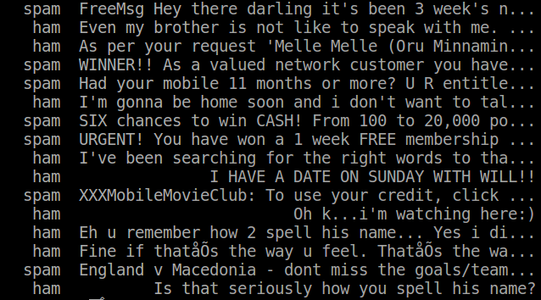
Neural Net for Spam classification

Slide 43
Preprocessing data

Slide 44
Demo: Neural Net for Spam classification

Slide 45
Convolutional Neural Net

Slide 46
Convolutional Neural Net
Convolution layer
Pooling layer
Dense layer

Slide 47
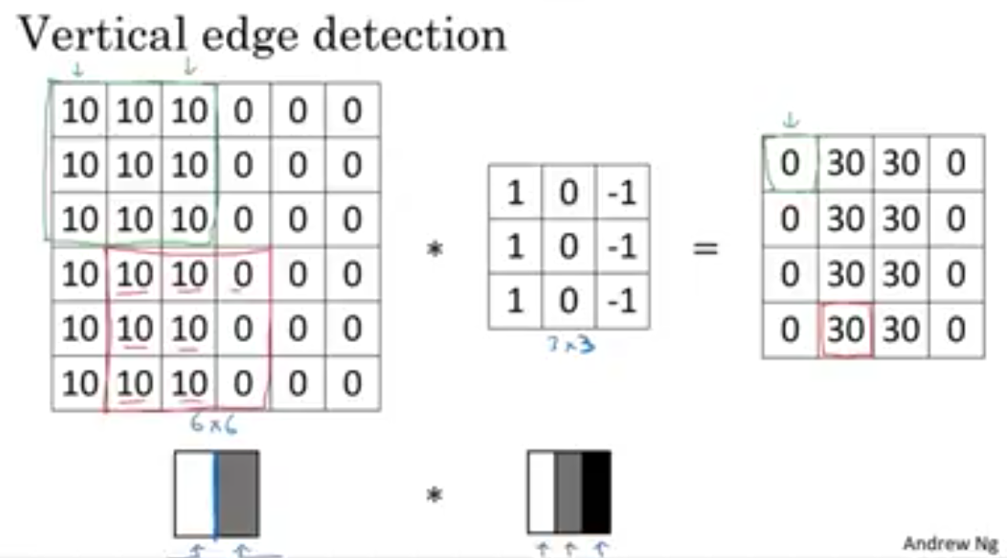

Slide 48
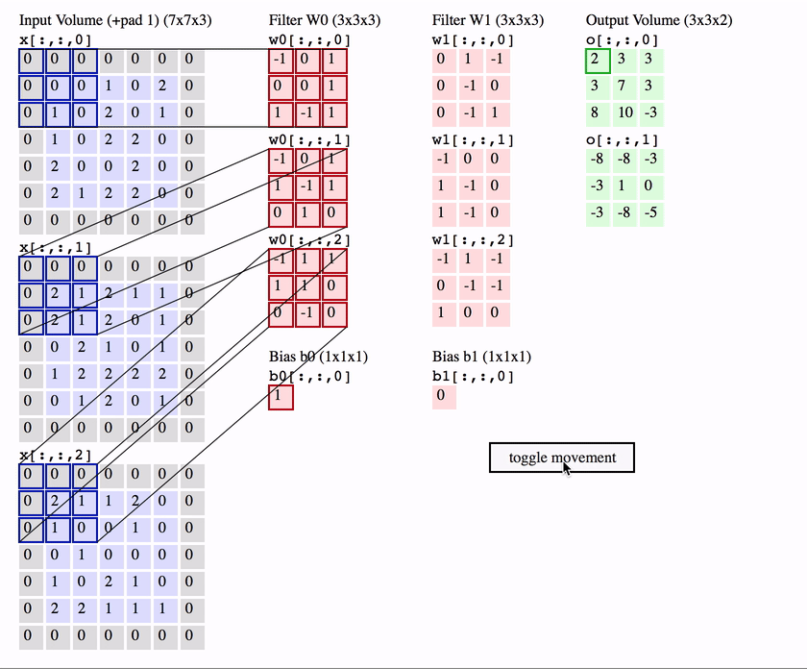

Slide 49
Optimization Algorithms
Loss function
Input Parameters
Trained
Parameters
Optimizer
{W, b}
{W, b}

Slide 50
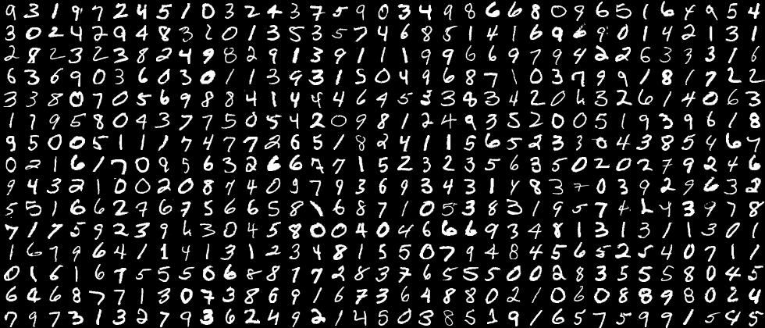
MNIST

Slide 51
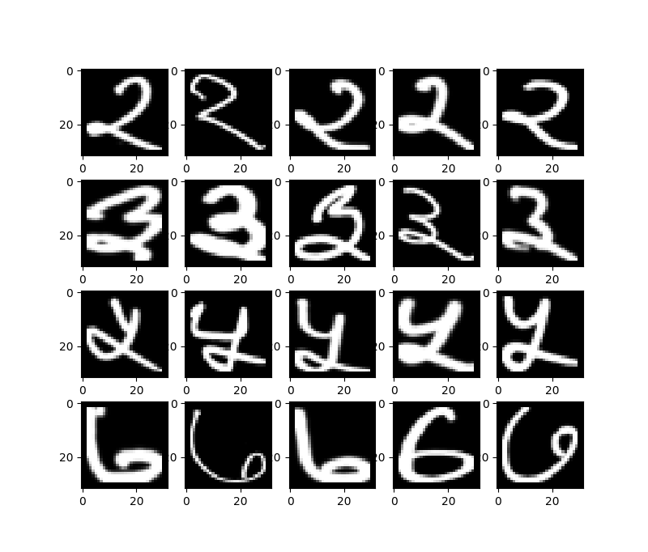
CNN for Devanagari digit classification

Slide 52
About Dataset
Grayscale image of size (32x32)
There are 1025 columns and 1200 rows.
Columns 1-1024 : contains the pixel values in range 0 to 255.
column 1025: Label

Slide 53
Demo: CNN for Devanagari digit classification

Slide 54

Imagenet
14 Million Images and 20,000 categories

Slide 55


Slide 56
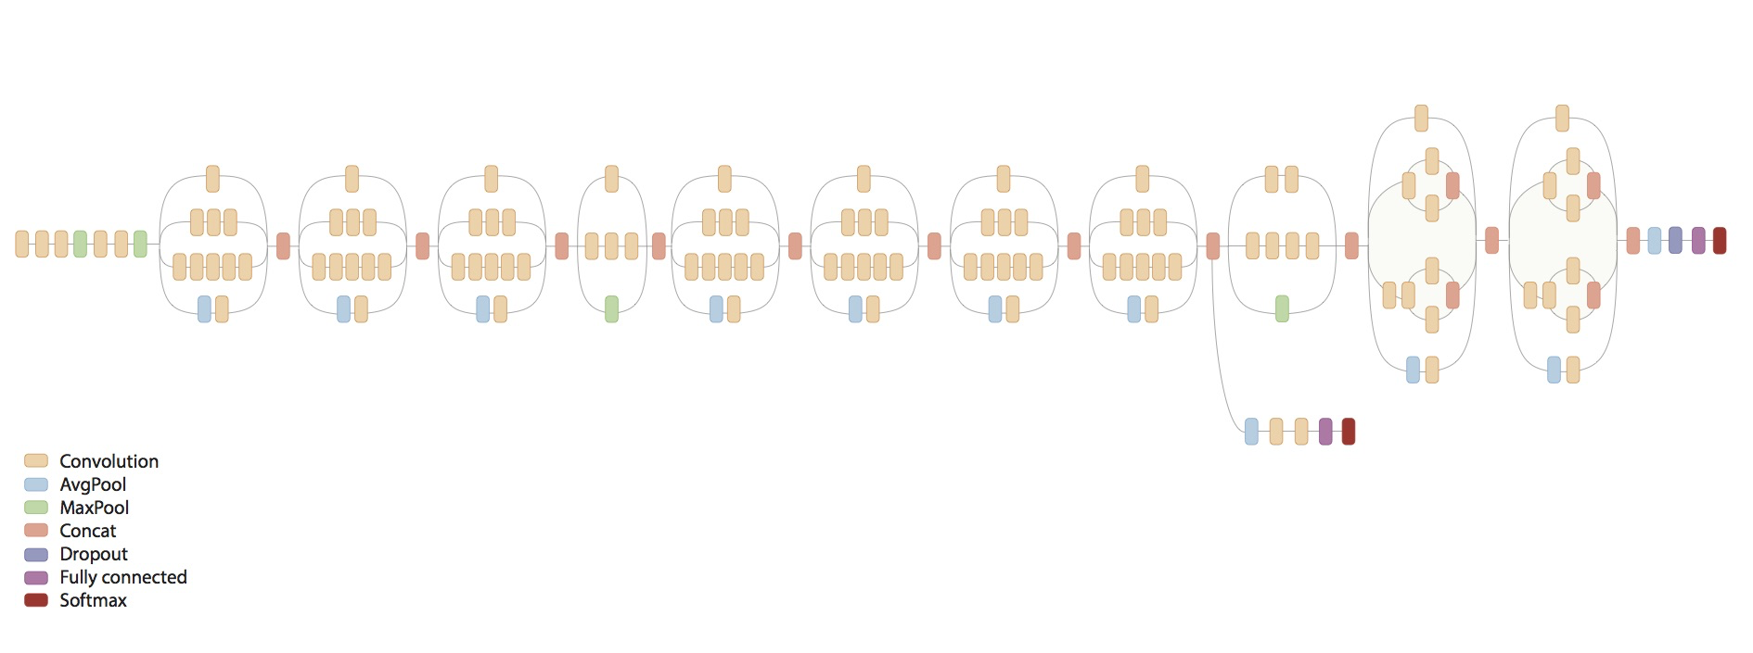
Inception V3
313 layers and 24M parameters

Slide 57
Demo: Inception V3

Slide 58

RNNs and LSTM

Slide 59
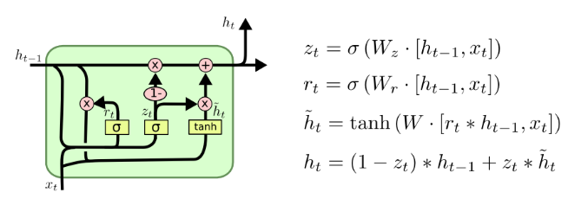
LSTM
https://colah.github.io/posts/2015-08-Understanding-LSTMs/

Slide 60
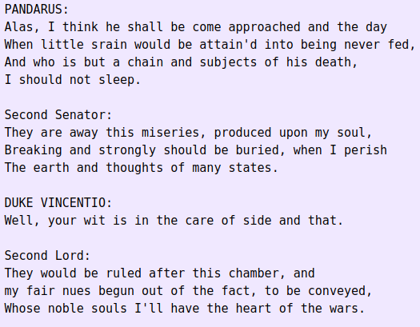
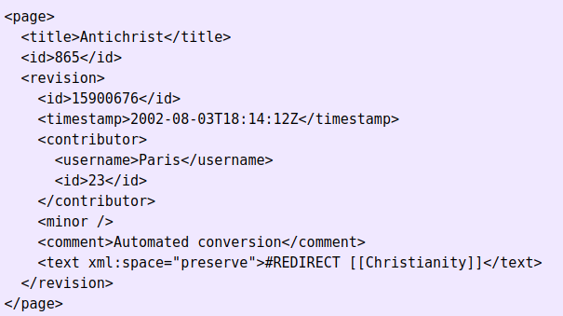
Unreasonable Effectiveness of RNN
http://karpathy.github.io/2015/05/21/rnn-effectiveness/
https://cs.stanford.edu/people/karpathy/recurrentjs/

Slide 61
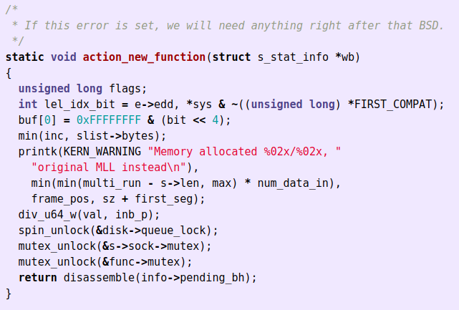
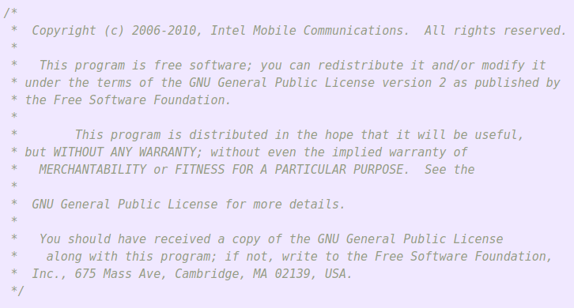
Unreasonable Effectiveness of RNN
http://karpathy.github.io/2015/05/21/rnn-effectiveness/
https://cs.stanford.edu/people/karpathy/recurrentjs/

Slide 62
LSTM for Fuzzing

Slide 63
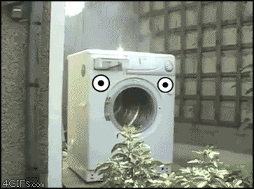
Fuzzing
Fuzzing?
Providing unexpected/random data
Crash the target system
Find security loopholes

Slide 64
Fuzzing: The problem
Huge documentation
Weeks of coding to write Grammar (understatement)
And we are lazy

Slide 65
Fuzzing: How Deep Learning helps
Generate a huge corpus of inputs
Train model to Infer grammar from inputs
Generate theoretically infinite test cases

Slide 66
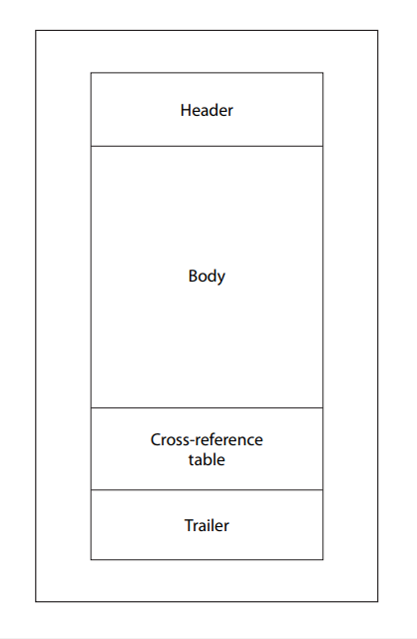
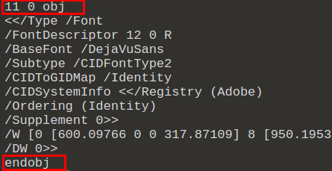
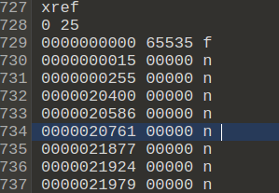
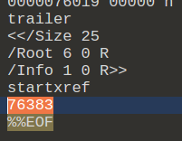
Fuzzing: PDF readers

Slide 67
LSTM
https://colah.github.io/posts/2015-08-Understanding-LSTMs/

Slide 68
Unreasonable Effectiveness of RNN
http://karpathy.github.io/2015/05/21/rnn-effectiveness/
https://cs.stanford.edu/people/karpathy/recurrentjs/

Slide 69
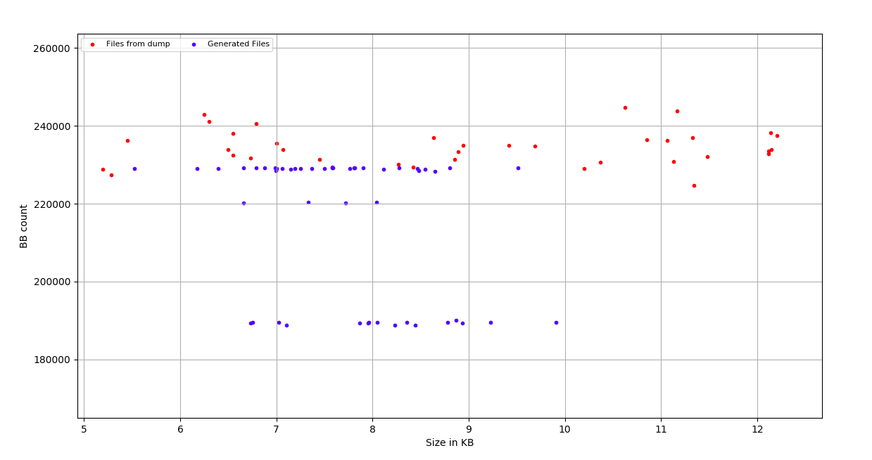
Fuzzing: Results
https://payatu.com/blog/Nikhil-Joshi/cloudfuzz-machine-learning-powered-content-specific-input-generation-fuzzing

Slide 70
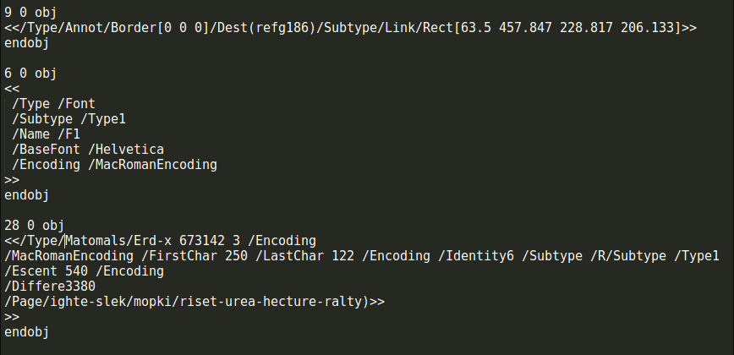
Fuzzing: Results
https://payatu.com/blog/Nikhil-Joshi/cloudfuzz-machine-learning-powered-content-specific-input-generation-fuzzing

Slide 71

Phishing
Fraudulent attempt to obtain sensitive/personal information
Multiple vectors
Mails, DMs, SMS, Social network, chat forums, etc.
Spear Phishing

Slide 72
Spear Phishing: The problem
Targeted
Understand interests of target
Takes hours of manual efforts
Higher success rate

Slide 73
Spear Phishing: How Deep Learning helps
Build a huge corpus of text from target’s social media feeds
Train a model to generate similar text using words from corpus

Slide 74
ML based Spear Phishing: Results
[+]20: Much awaited talk given by @imohitch at @PydataPune @PythonPune for AI"<link>
[+]12: Thanks!! <link> CFP deadline: Jun 20 - 12 #PyDataPune <link>
[+]5: It was a comment. <link>
#python #pydatapune #HouseOfResearch @RedHat. Worked on xarray - R and action plan.
@RedHat #MachineLearning #DataScience #PyDataPuneMeetups
[+]9: Yo! I find the Newsletter.
@PydataPune @PyData @NumFOCUSpic.twitter.com/T5ydVfF5PR
[+]13: <link> May 19, 2018. We are PyDaters.
Thanks @katyhuff
@PyData @NumFOCUS #python #pune #machinelearning #dataviz #openscience #nonprofit #swagpic.twitter.com/j9JhQy9Pus
[+]7: Interested in today’s @WiDSPune2019 on numpy and show your Attention please!!! The goal is going @pranshutople14 conclude the maths behind NeuralNets <link>
#PyData #NumFOCUS @PyData #PyData_Meetup @Pune @machinelearnflx @Pune

Slide 75
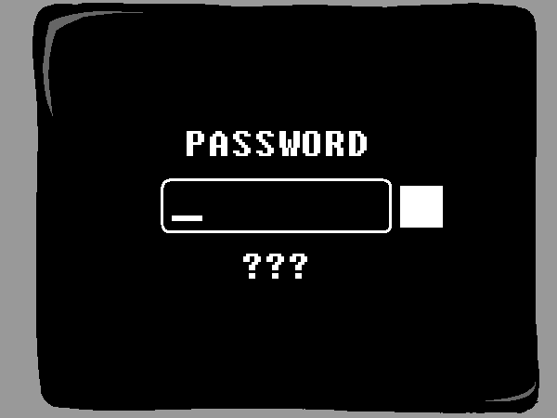
Dictionary attacks
Dictionary contains commonly used password
Try every password from dictionary unless you succeed
Attack may work if the password is similar to
Pydata_123$$
##pydata##Pun3
PyData@@098

Slide 76
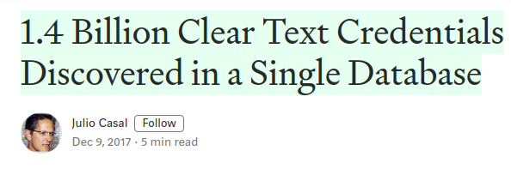
Dictionary attacks: data collection

Slide 77
Dictionary attacks: Approach
Skeletonize the passwords
<first_name>_<last_name>##123
<dob><mob><First_name>
<dob><mob>_<Lastname>$$
<last_name>##<random_num>
Etc ...
Train generative models on corpus of skeletons
Basic personal info + skeletons = passwords

Slide 78
Thanks
@adversarial_nik

